Slide 1


Municipal Drinking Water in the Athabasca Region – Understanding the Process
Presentation for Science Outreach – November 27, 2014

Slide 2
What .. I mean who is the Aspen Regional Water Services Commission?

Slide 3

The Aspen Regional Water Services Commission (ARWSC) is a Municipal Corporation established under the Municipal Government Act of Alberta.
The ARWSC operates a Regional Water Treatment Plant and Transmission Line regulated under the Environmental and Protection Act of Alberta, Operating Approval 254323-00-01 and holds a water License No. 00248506-00-00 under the Water Act of Alberta.
The objective of the ARWSC is to provide wholesale potable water to it’s Members (Municipalities).

Slide 4

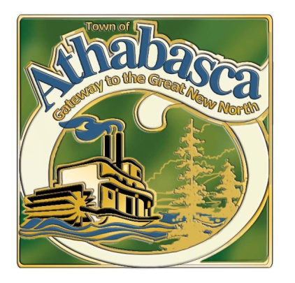


Three partners

Slide 5
Board of Directors
2 Elected Officials from the Town of Athabasca
2 Elected Officials from the Village of Boyle
2 Elected Officials from Athabasca County
Commission Manager
Operations Staff
Alberta Environment Certified Operators
Administrative Services Coordinator

Slide 6
So Why Water Commissions?
Like many regions of the province approximately 15 years ago the public and municipal officials recognized a need to upgrade many of the municipal potable water systems in Alberta.
Science and water treatment plant technologies were quickly advancing; aging infrastructure and growing populations were stressing existing facilities; shortages of skilled operators, particularly in smaller communities were a concern and serious failures such as the well documented incidences in Walkerton, Ontario and North Battleford, Saskatchewan resulted in the public clearly communicating their desire for safe reliable drinking water in Alberta.

Slide 7
But did the Athabasca region drinking water systems need upgrades and a Commission?
In 2003, Athabasca County commissioned Associated Engineering to complete a Regional Water Supply System Feasibility Report and they reported the following;
“Some of the existing water supply facilities are nearing capacity or have raw water supply challenges and upgrades are presently being reviewed. Changes to the Alberta Environment Standards will require a higher level of water treatment which will result in costly upgrades.”
County of Athabasca- Regional Water Supply System Feasibility Report – November, 2003

Slide 8
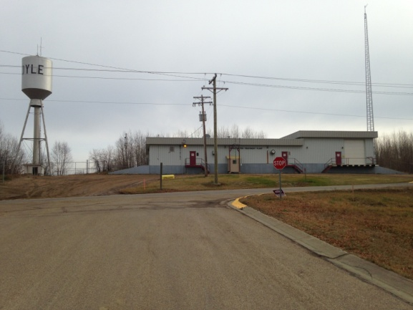
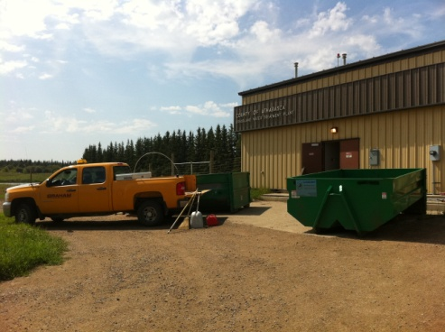
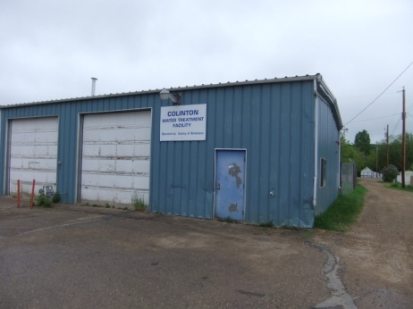
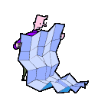
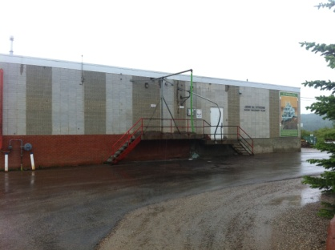
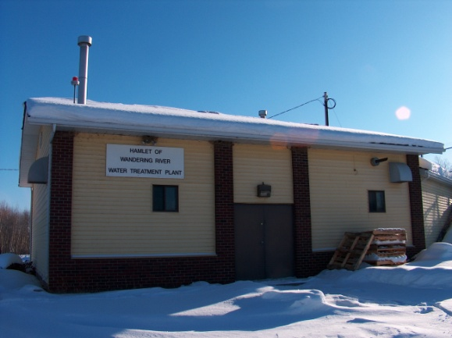
Village of Boyle WTP
Athabasca County Grassland WTP
Athabasca County Colinton WTP
Prior to the Commission, potable water supply in the Region was de-centralized. The feasibility study considered the regions existing water treatment plants.
Athabasca County Wandering River WTP
Town of Athabasca WTP

Slide 9
Many of the decentralized water treatment plants in the region had limited and/or less than ideal source water.
“Raw Water Supply Challenges”
Water Treatment Plant | Source | Concerns
Athabasca Water Treatment Plant | Athabasca River at Athabasca | Highly variable flows and potential for upstream contamination and flooding.
Colinton Water Treatment Plant | Water Well - Ground Water | Iron and the related operational difficulties.
Boyle Water Treatment Plant | Skeleton Lake | Skeleton Lake’s Water Level was declining. Limited water supply. Alberta Environment imposed restrictions.
Grassland Water Treatment Plant | Road Ditch - Seasonal Run Off | Limited supply and potential for contamination. Some dissolved organics and disinfection by-product concerns.
Wandering River Water Treatment Plant | Wandering River – Only seasonal intake. Raw water holding pond insufficient to supply winter demand to community. | Limited supply and significant dissolved organics, disinfection by-product concerns and iron and manganese.

Slide 10
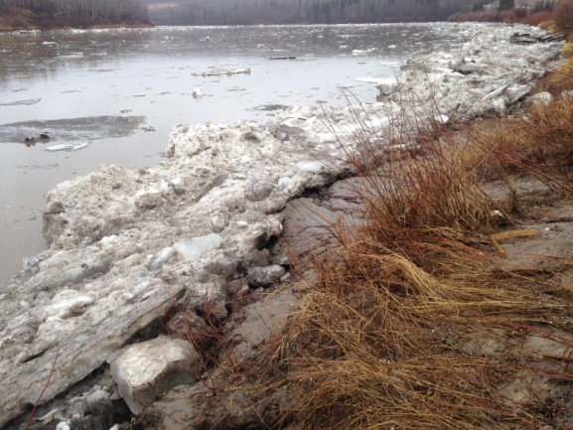
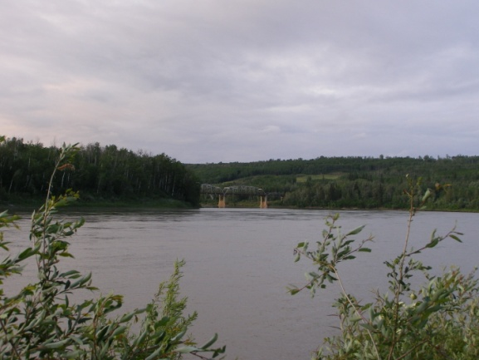
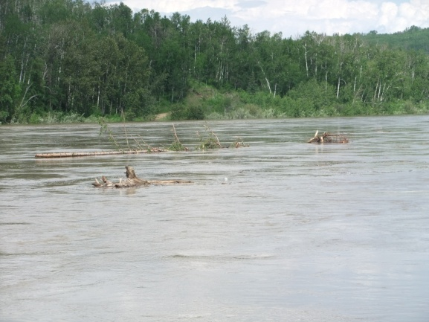
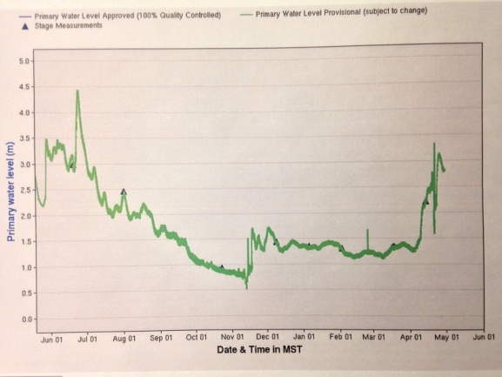
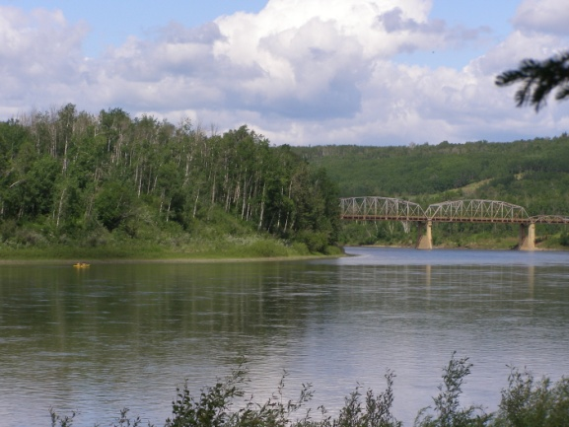
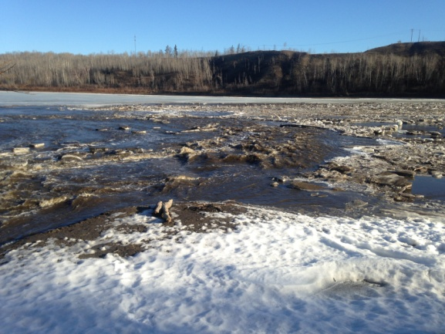
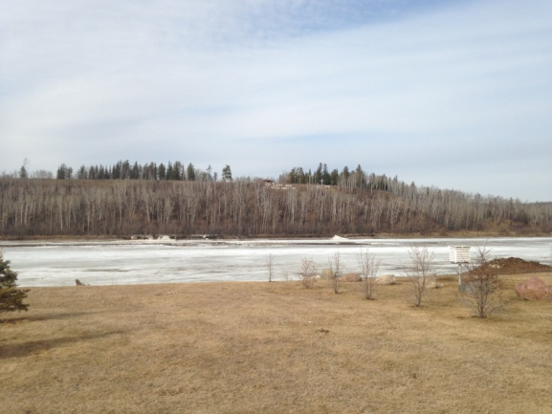
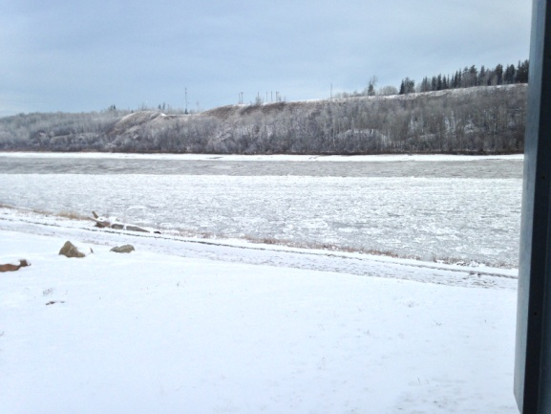
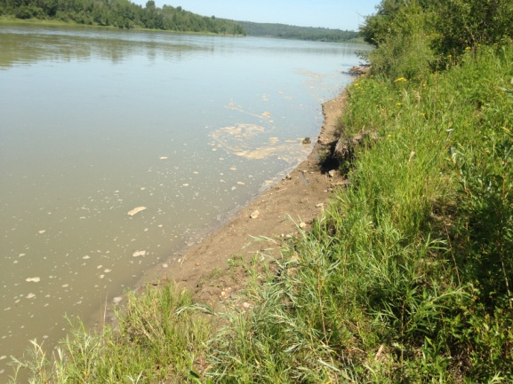
Athabasca River at Athabasca - Seasonal Variability

Slide 11
Many of the decentralized water treatment plants in the region had limited and/or less than ideal source water.
“Raw Water Supply Challenges”
Water Treatment Plant | Source | Concerns
Athabasca Water Treatment Plant | Athabasca River at Athabasca | Highly variable flows and potential for upstream contamination and flooding.
Colinton Water Treatment Plant | Water Well - Ground Water | Iron and the related operational difficulties.
Boyle Water Treatment Plant | Skeleton Lake | Skeleton Lake’s Water Level was declining. Limited water supply. Alberta Environment imposed restrictions.
Grassland Water Treatment Plant | Road Ditch - Seasonal Run Off | Limited supply and potential for contamination. Some dissolved organics and disinfection by-product concerns.
Wandering River Water Treatment Plant | Wandering River – Only seasonal intake. Raw water holding pond insufficient to supply winter demand to community. | Limited supply and significant dissolved organics, disinfection by-product concerns and iron and manganese.

Slide 12
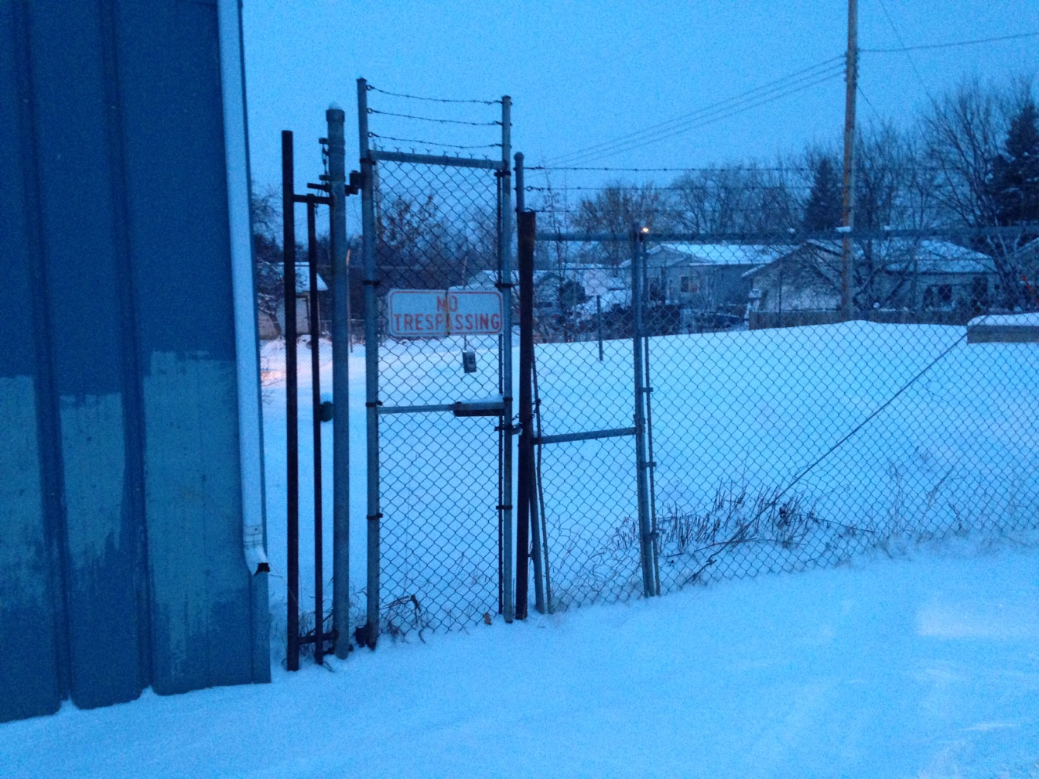
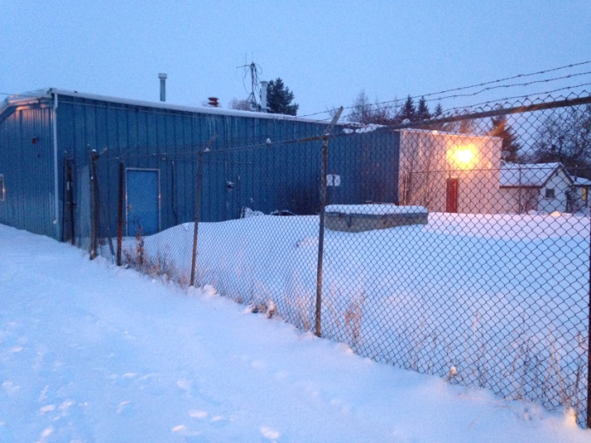
Colinton

Slide 13
Many of the decentralized water treatment plants in the region had limited and/or less than ideal source water.
“Raw Water Supply Challenges”
Water Treatment Plant | Source | Concerns
Athabasca Water Treatment Plant | Athabasca River at Athabasca | Highly variable flows and potential for upstream contamination and flooding.
Colinton Water Treatment Plant | Water Well - Ground Water | Iron and the related operational difficulties.
Boyle Water Treatment Plant | Skeleton Lake | Skeleton Lake’s Water Level was declining. Limited water supply. Alberta Environment imposed restrictions.
Grassland Water Treatment Plant | Road Ditch - Seasonal Run Off | Limited supply and potential for contamination. Some dissolved organics and disinfection by-product concerns.
Wandering River Water Treatment Plant | Wandering River – Only seasonal intake. Raw water holding pond insufficient to supply winter demand to community. | Limited supply and significant dissolved organics, disinfection by-product concerns and iron and manganese.

Slide 14
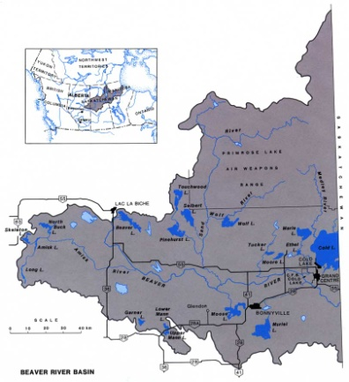
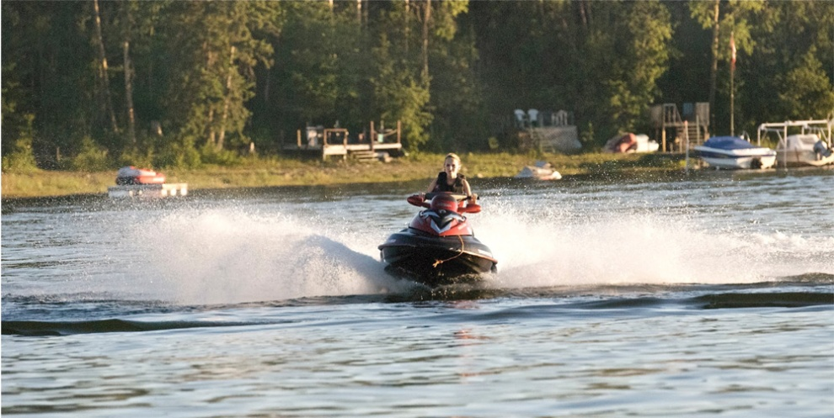
Boyle/Skeleton Lake

Slide 15
Many of the decentralized water treatment plants in the region had limited and/or less than ideal source water.
“Raw Water Supply Challenges”
Water Treatment Plant | Source | Concerns
Athabasca Water Treatment Plant | Athabasca River at Athabasca | Highly variable flows and potential for upstream contamination and flooding.
Colinton Water Treatment Plant | Water Well - Ground Water | Iron and the related operational difficulties.
Boyle Water Treatment Plant | Skeleton Lake | Skeleton Lake’s Water Level was declining. Limited water supply. Alberta Environment imposed restrictions.
Grassland Water Treatment Plant | Road Ditch - Seasonal Run Off | Limited supply and potential for contamination. Some dissolved organics and disinfection by-product concerns.
Wandering River Water Treatment Plant | Wandering River – Only seasonal intake. Raw water holding pond insufficient to supply winter demand to community. | Limited supply and significant dissolved organics, disinfection by-product concerns and iron and manganese.

Slide 16
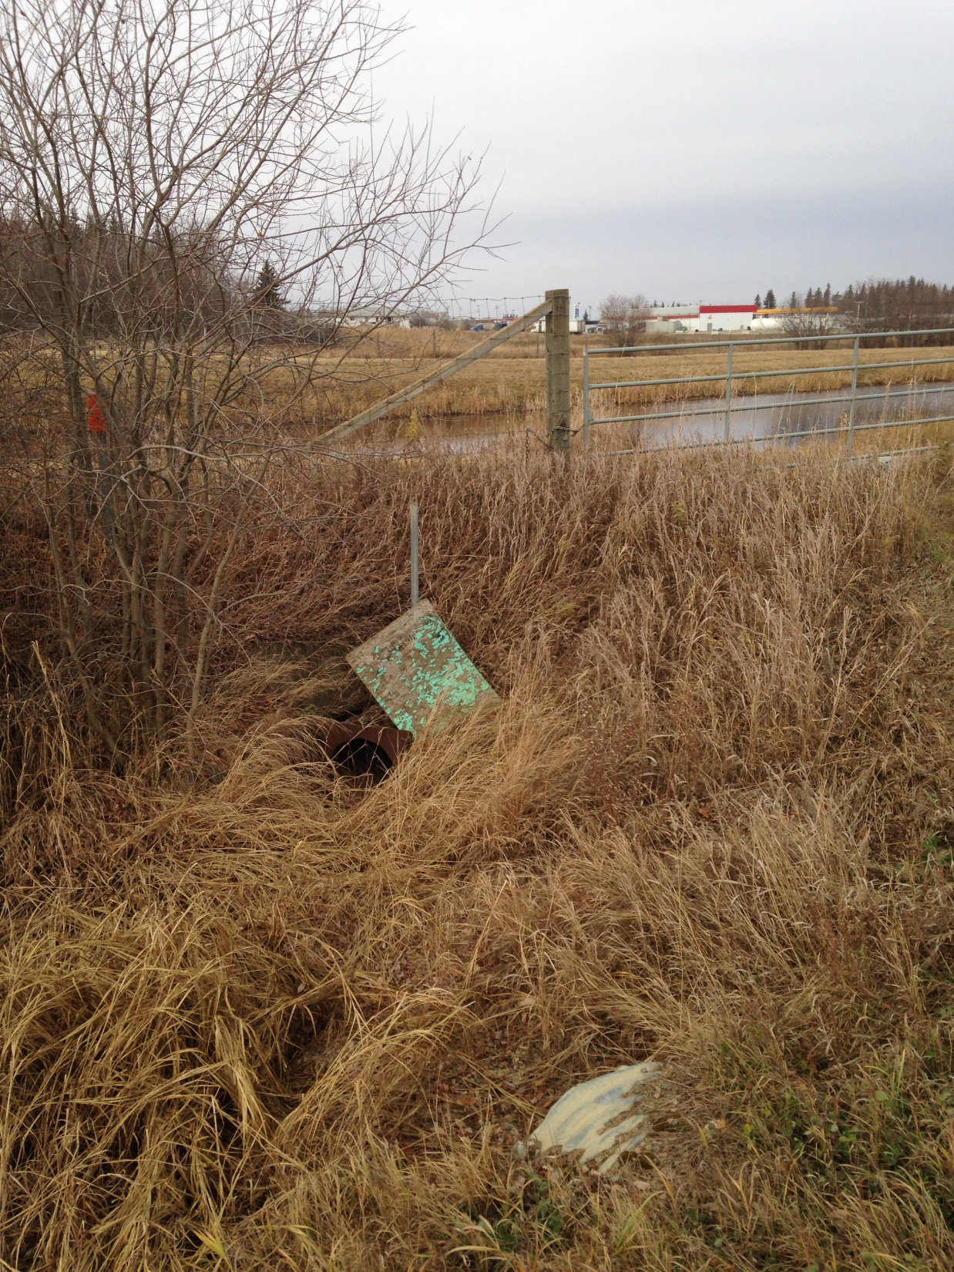
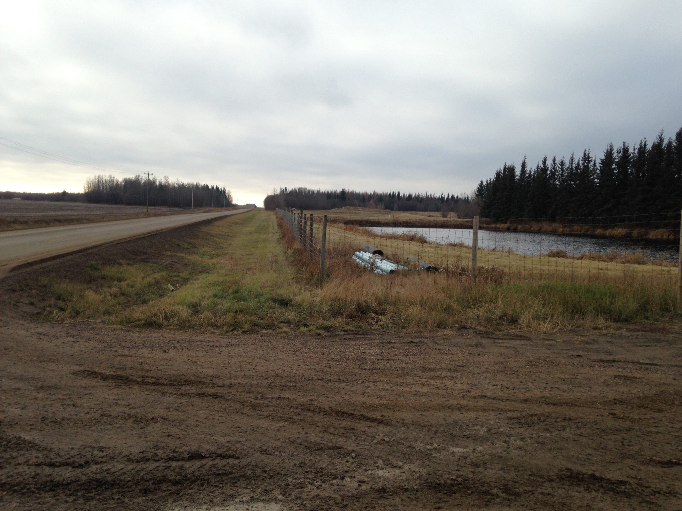
Grassland / Road Ditch and Dugout

Slide 17
Many of the decentralized water treatment plants in the region had limited and/or less than ideal source water.
“Raw Water Supply Challenges”
Water Treatment Plant | Source | Concerns
Athabasca Water Treatment Plant | Athabasca River at Athabasca | Highly variable flows and potential for upstream contamination and flooding.
Colinton Water Treatment Plant | Water Well - Ground Water | Iron and the related operational difficulties.
Boyle Water Treatment Plant | Skeleton Lake | Skeleton Lake’s Water Level was declining. Limited water supply. Alberta Environment imposed restrictions.
Grassland Water Treatment Plant | Road Ditch - Seasonal Run Off | Limited supply and potential for contamination. Some dissolved organics and disinfection by-product concerns.
Wandering River Water Treatment Plant | Wandering River – Only seasonal intake. Raw water holding pond insufficient to supply winter demand to community. | Limited supply and significant dissolved organics, disinfection by-product concerns and iron and manganese.

Slide 18
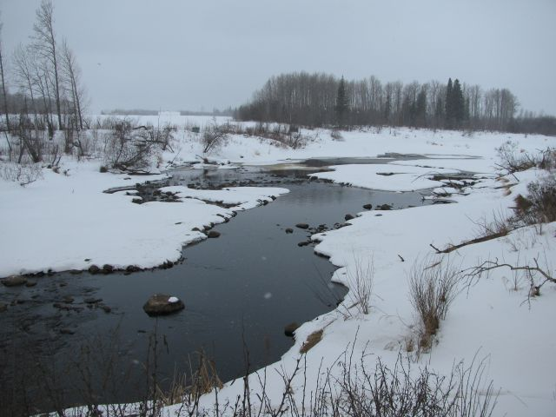
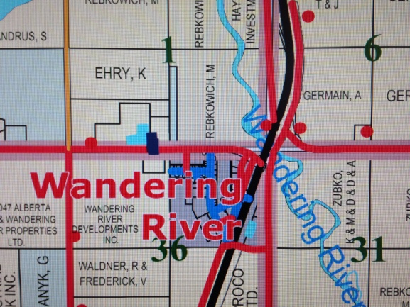
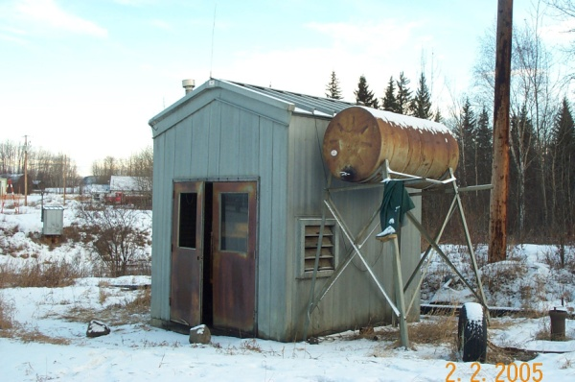
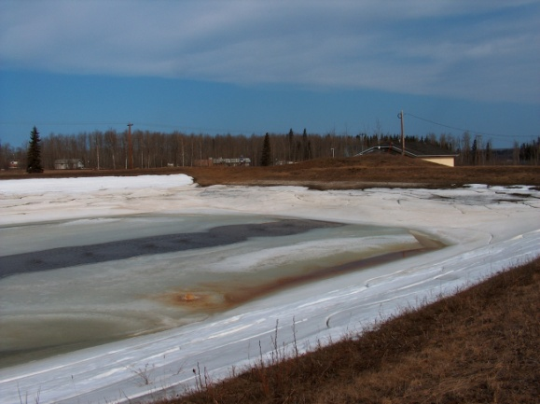
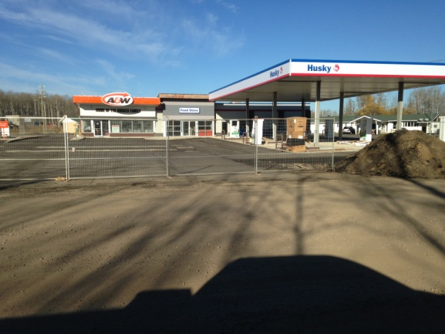
Wandering River / Seasonal intake and holding pond

Slide 19
The Region’s Water Treatment Plants Prior to Commission
Water Treatment Plant | Type of Plant | Established and Upgrades
Athabasca WTP | Conventional-ish clarifiers and multi -media (sand) filters that backwashed to Athabasca River – Free Chlorine | 1914,1950’s,1980’s
Colinton WTP | Ion exchange - Free Chlorine | ?, 1990’s
Boyle WTP | Package clarifier/multi-media (sand) filters sand – Free Chlorine disinfection
Grassland WTP | Package clarifier/multi-media (sand) filters sand – Free Chlorine disinfection | 1970’s or 80’s, 1990’s
Wandering River WTP | Package clarifier/multi media (sand) filters sand – Free Chlorine disinfection | 1970’s, 1990’s

Slide 20
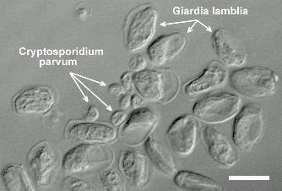
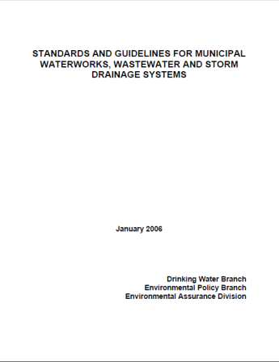
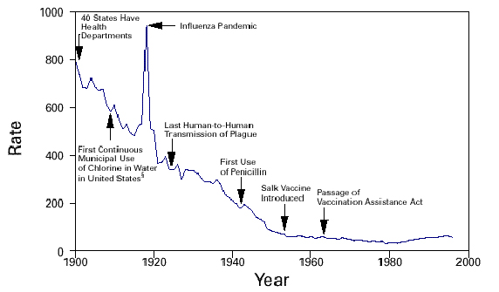
But what is required in a Water Treatment Plant or a regional system in 2009?
The Science has evolved!
Water Treatment has evolved!
Even the regulator evolved!
How do you make it happen?

Slide 21
One solution is - REGIONALIZATION
Pool Resources
Optimize Technologies
Optimize Human Resources
Energy Efficiencies
Use more sustainable raw water sources - that allow
for growth and development
Improved source water
Flood security
Security
Redundancies
Accounting for wastewater (to lagoon) and efficiencies
More service and better quality water
.......meeting the Standards

Slide 22
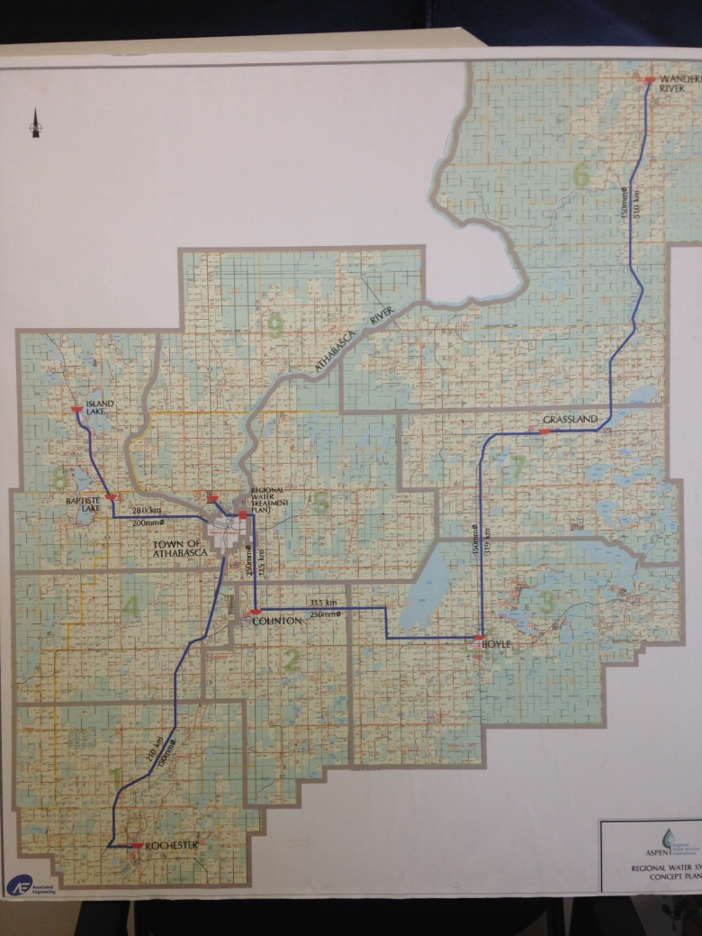
The decision was made to develop one Regional Water Treatment Plant using the Athabasca River as source water and use a system of regional transmission mains to supply water to member municipalities.

Slide 23

Timeline
2003 – Regional Steering Committee formed
2003 – Regional Water Feasibility Study
2004 – County of Athabasca, Colinton Pipeline Pre-design
Report/Construction 2006 – 2007
2006 – Ultimate Regional Water Feasibility Study
2008 – Aspen Regional Water Services Commission formally
established
2008 – Regional Water Treatment Plant Stage 1 Design Brief/Boyle
Regional Water Pipeline Pre-design Report
2008 – 2010 Regional Contracts Construction
2011 – 2012 Construction of Water Line from Boyle to Wandering River
2013 – New Wandering River Reservoir Complete

Slide 24
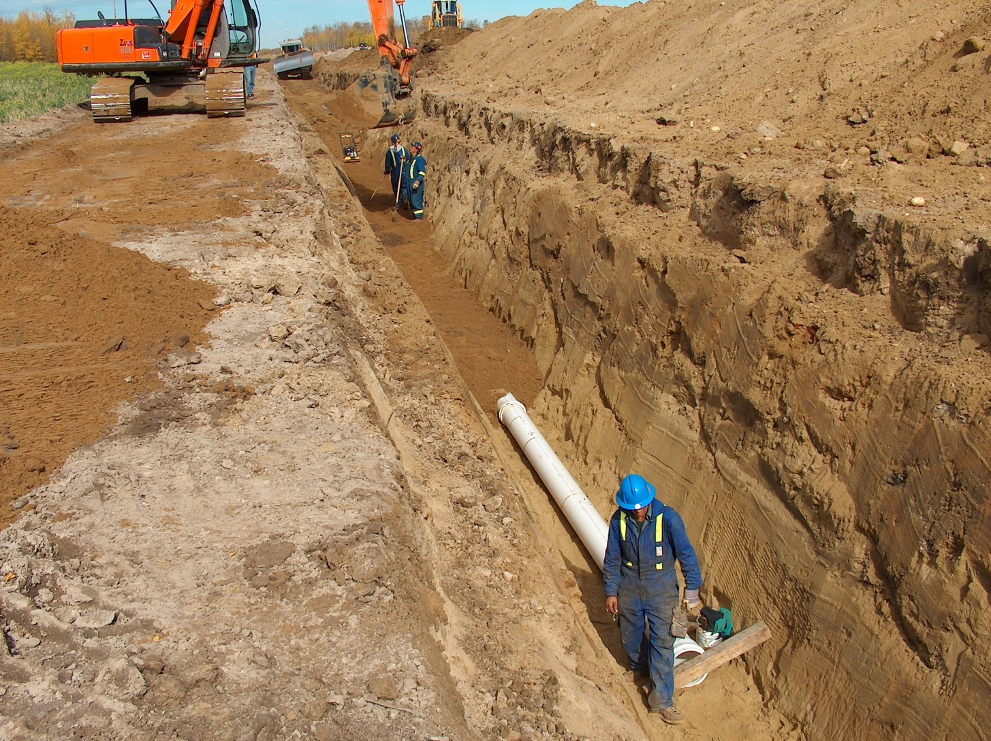
Contract #1 – A Pipeline from Athabasca to Colinton and Construction of the new Colinton Reservoir

Slide 25
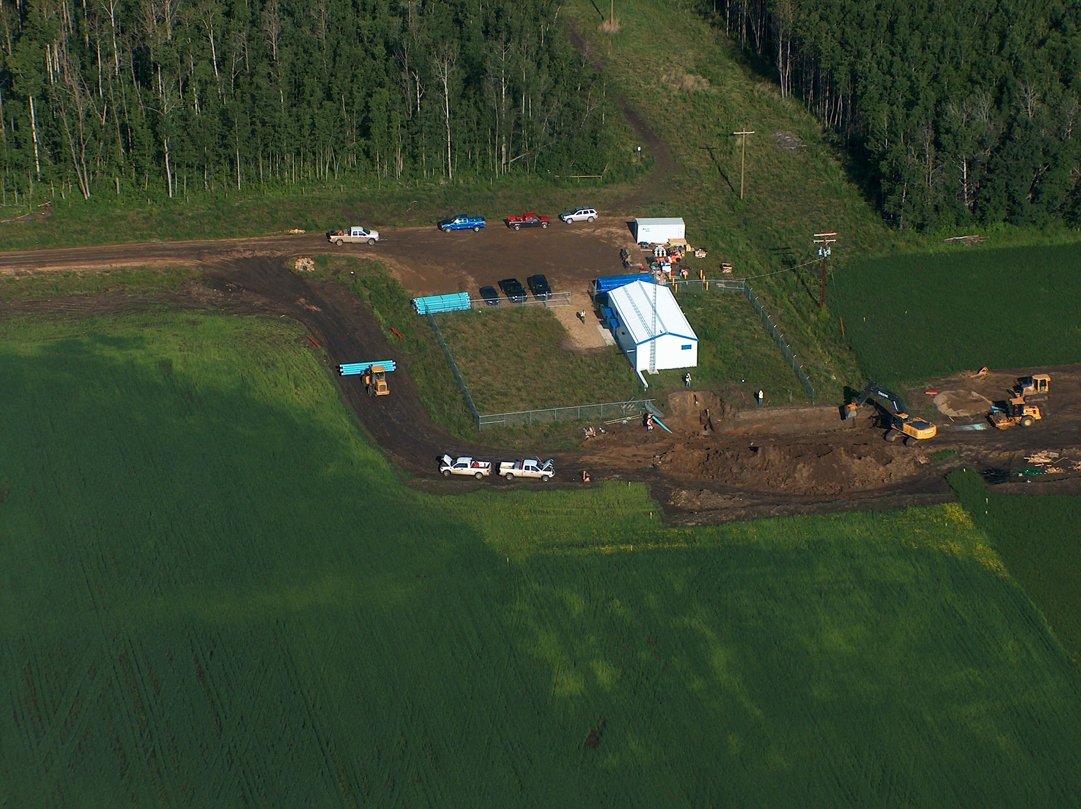

Slide 26
Colinton Reservoir Facts
1,000 m³ storage
  “balancing reservoir” for regional system
Chlorine monitoring and dosing system
Two 75 HP pumps
One 5 HP jockey pump

Slide 27
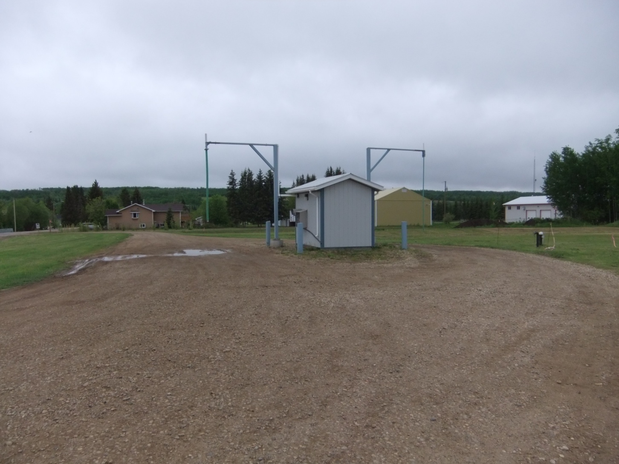
The first phase of regionalization is complete

Slide 28
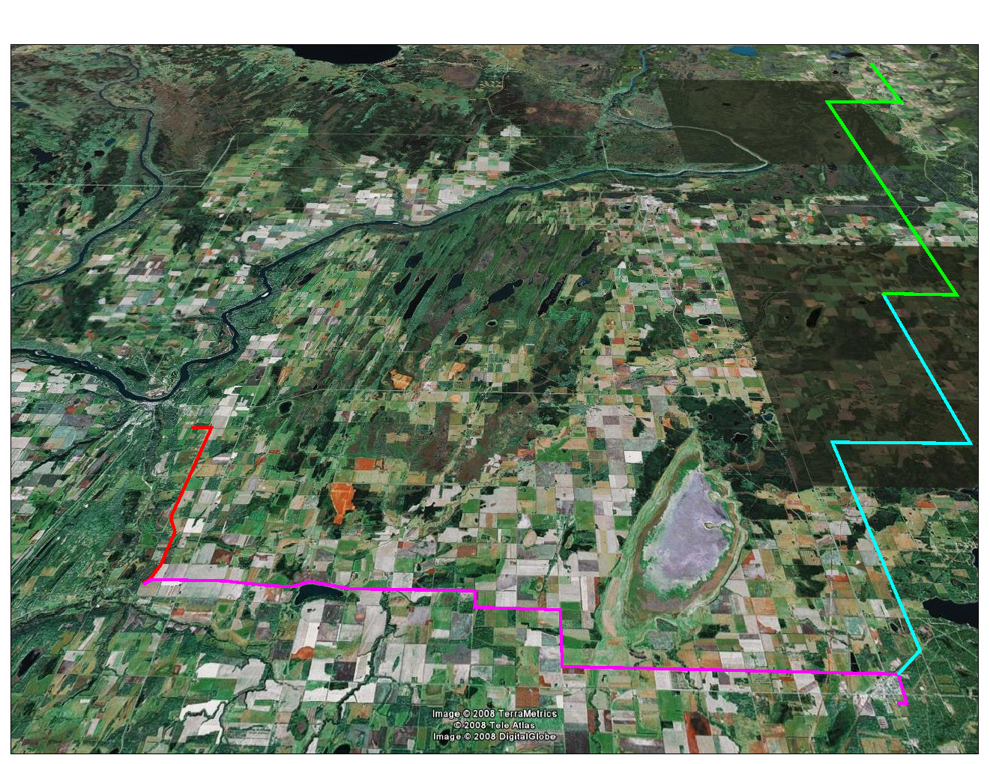
Wandering River
Grassland
Athabasca
Colinton
Boyle

Slide 29
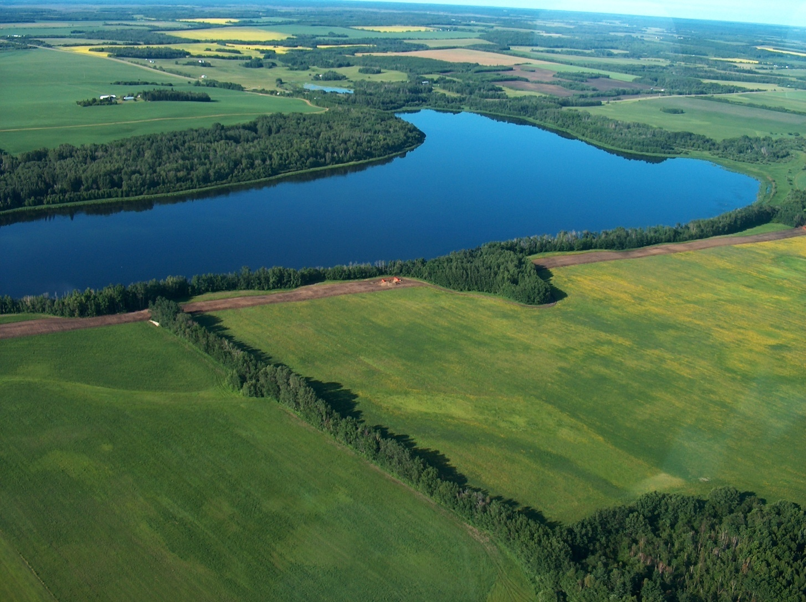
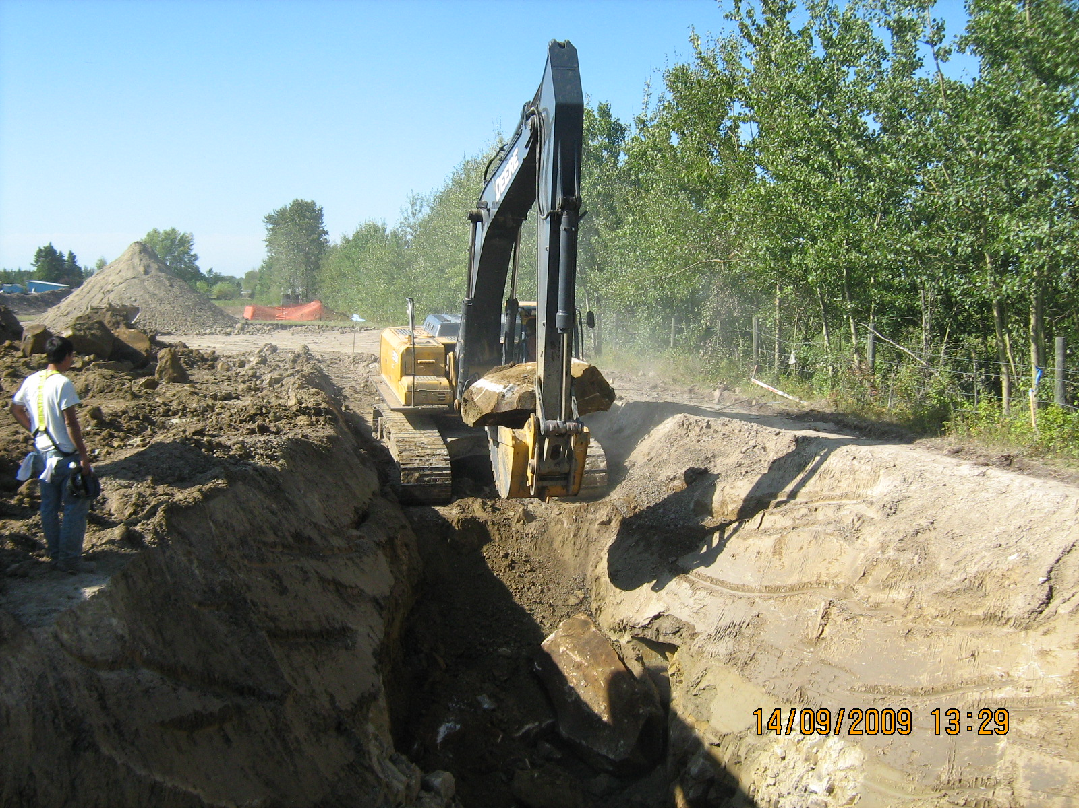
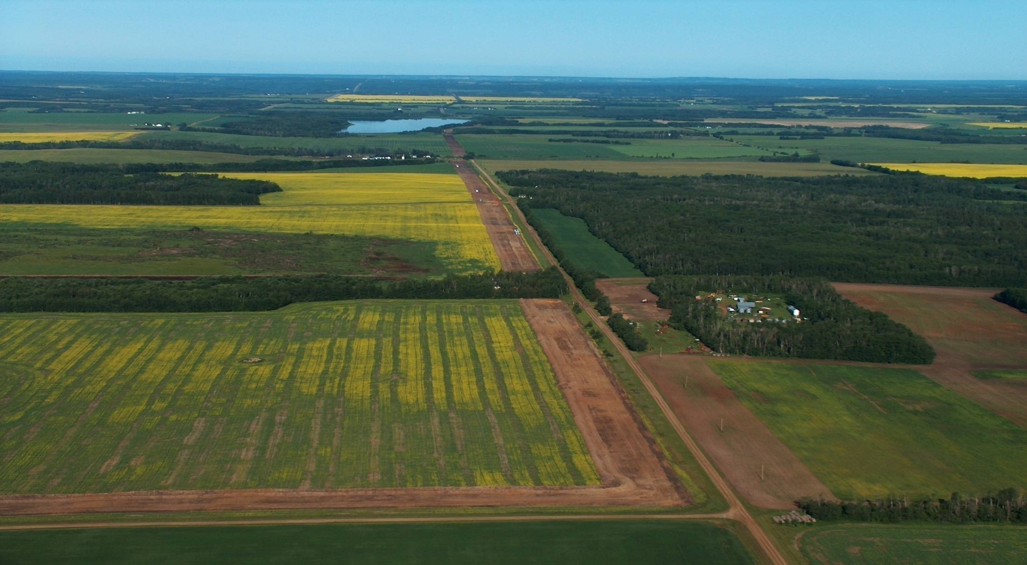
In 2009 the Water Line is Extended to Boyle

Slide 30
Wandering River
Grassland
Athabasca
Colinton
Boyle

Slide 31
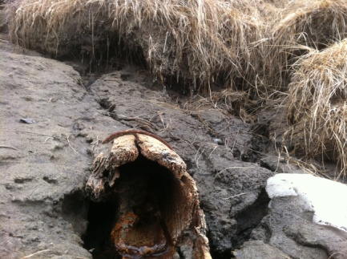
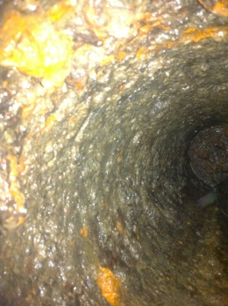
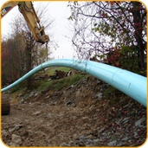
The pipeline was completed to Boyle in 2009 – step two of regionalization is complete
Length
  Colinton Pipeline = 12 km
  Boyle Pipeline = 33.5 km
Design Flow
  2,731 people plus allowance for rural
  Design flow = 34.5 l/s
Pipe
  250 mm diameter
  Polyvinyl Chloride (PVC)
Private Service Connections
Water Co-op Stubs

Slide 32
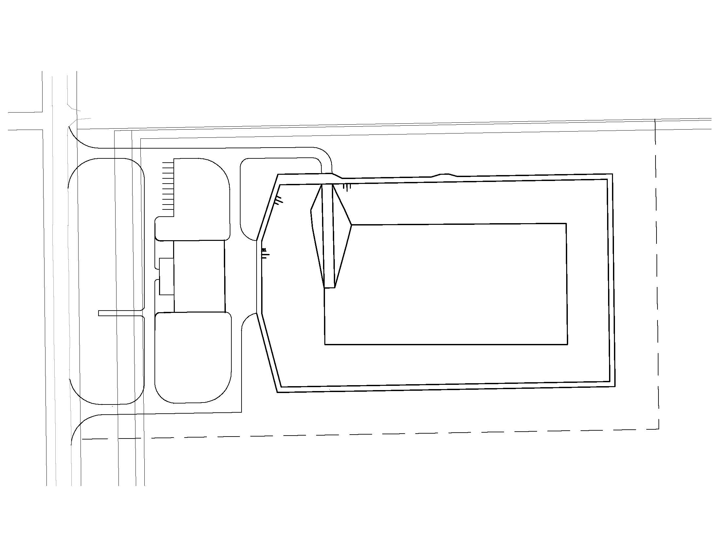
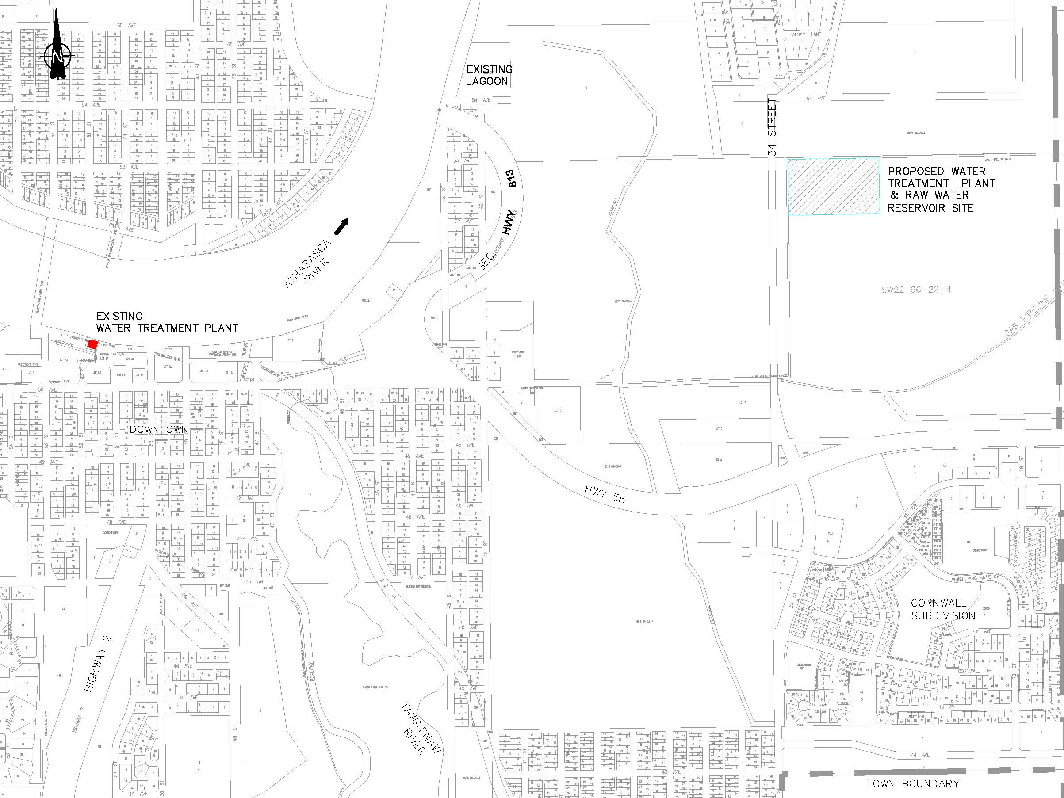
Highway Realignment
Sanitary Discharge
Raw Water Pumping Station
Raw Waterline
Distribution Line

Slide 33
The Regional Water Treatment Plant was under construction in 2009 considering the following water supply specifications
  Raw Water Supply
    450 mm diameter pipeline sized for 25 year demand
    74,000 m³ reservoir, sized for 7 days storage
  WTP
    Treatment Capacity = 6,300 m³ /d (7,000 people)
    Expansion to 9,500 m³ /day (10,500 people)
    Potable water reservoir = 3,000 m³
    Distribution pumps to supply Town and Regional System

Slide 34
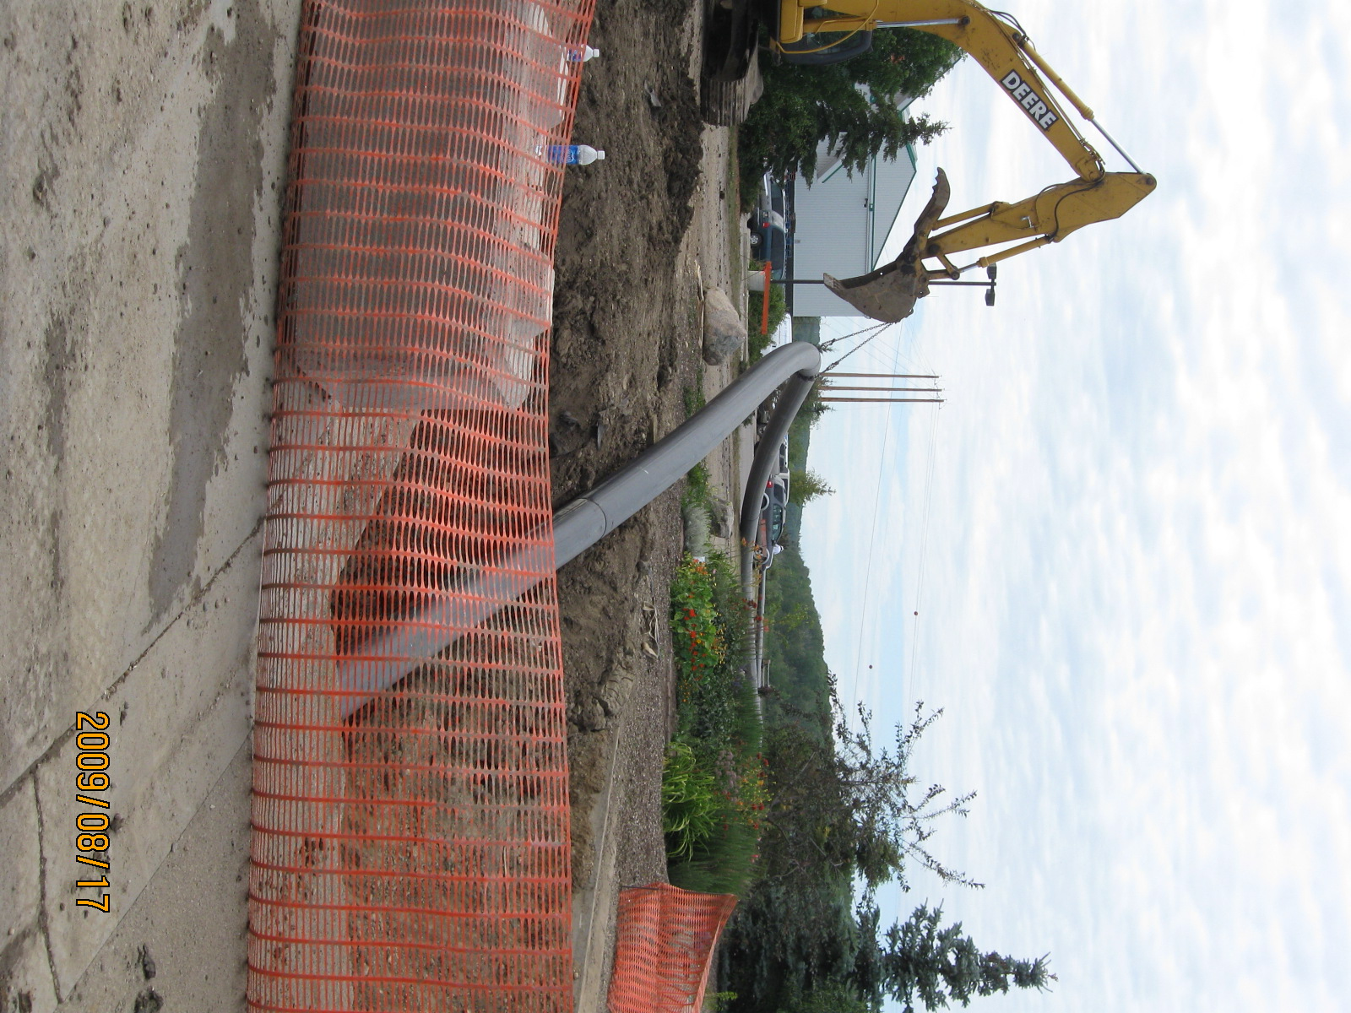

Slide 35
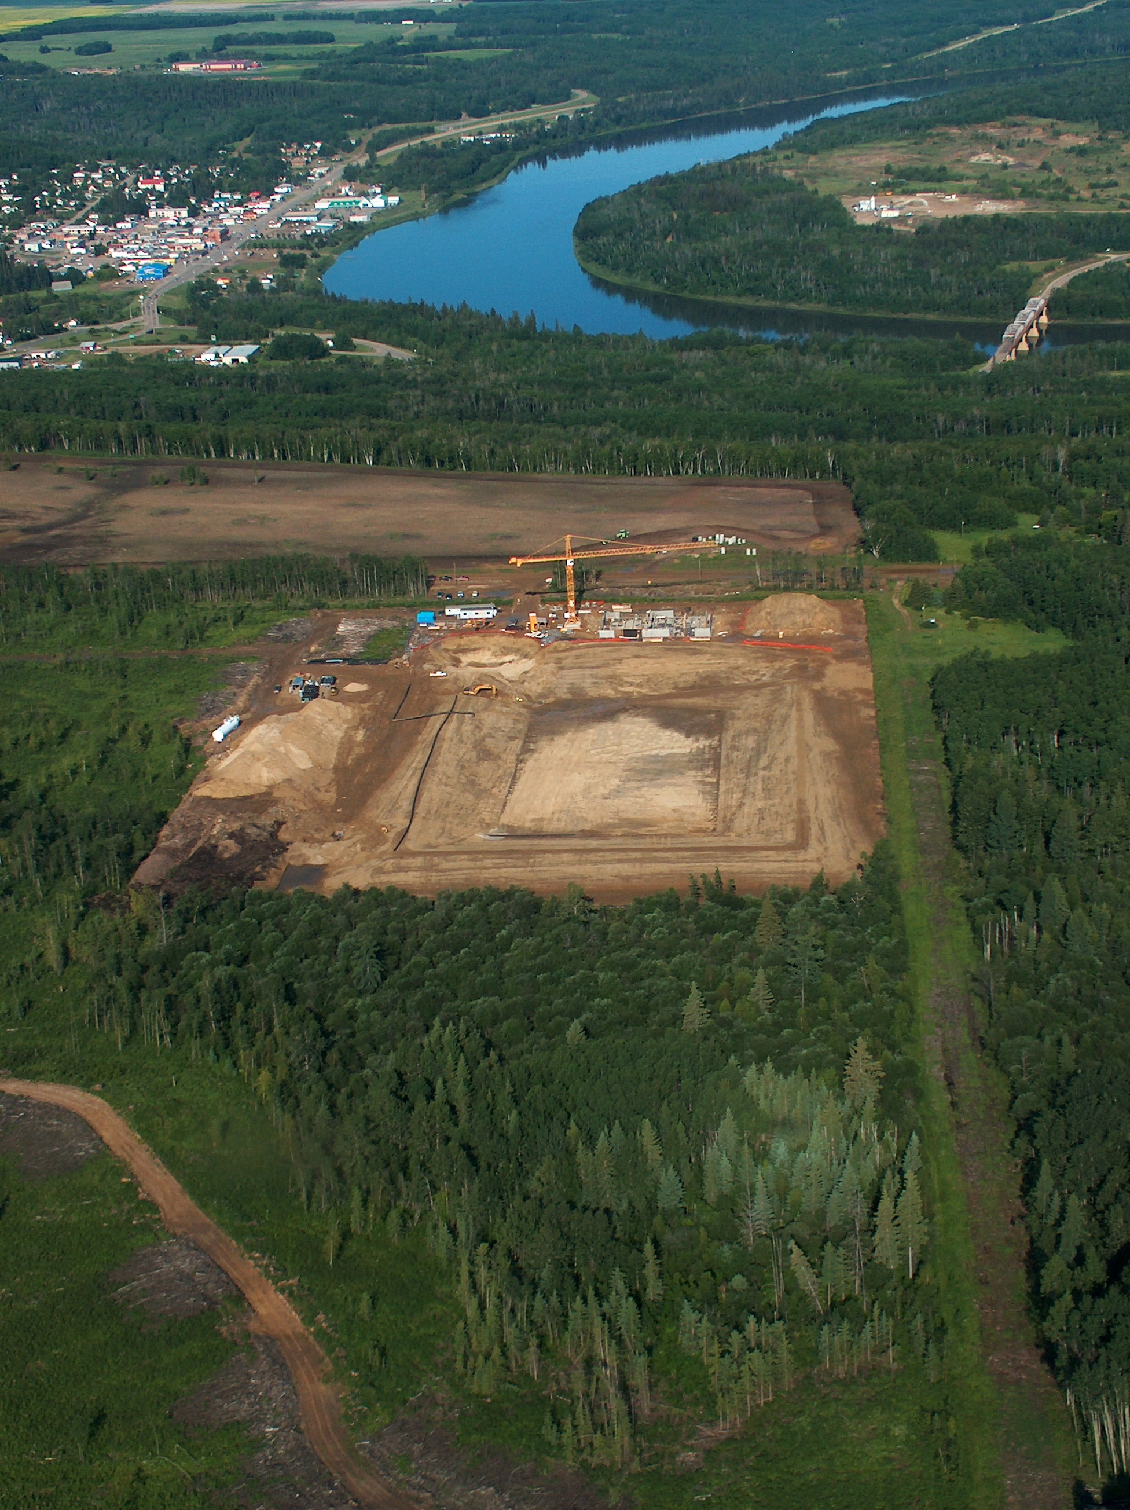

Slide 36
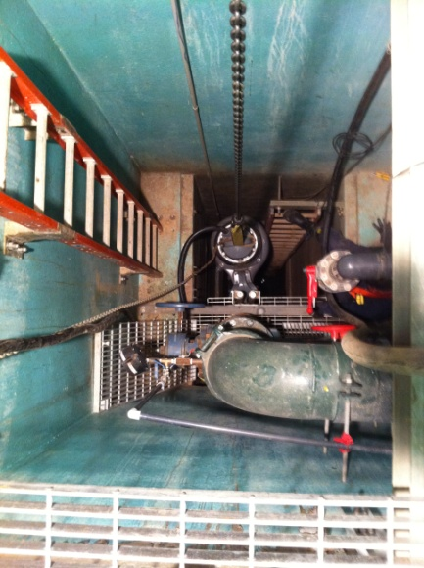
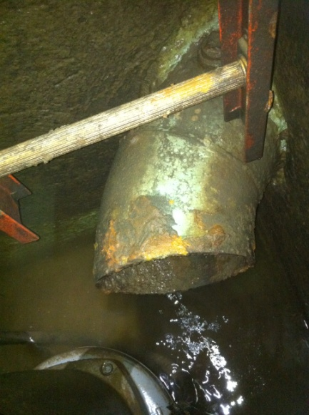
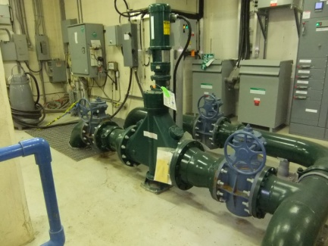
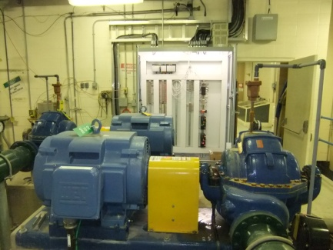
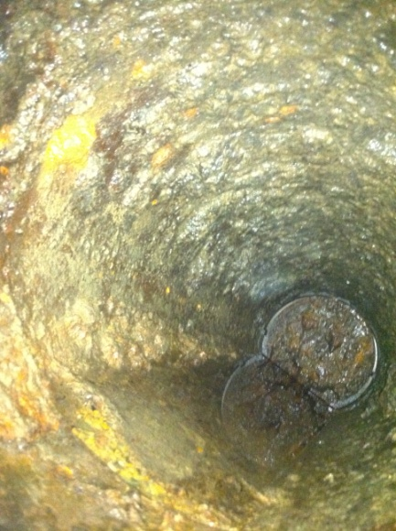


Raw Water Pumping - Debris Management

Slide 37


Slide 38







Raw Water Pond

Slide 39
Back to Summer 2010
The regional treatment plant is nearing completion
Renovations are under way to complete the raw water delivery system to the regional WTP site
The old town water treatment plant is still operating

Slide 40

The Regional Water Treatment Plant

Slide 41

Regional Water Treatment Plant
Process Floor

Slide 42

Regional Water Treatment Plant
Clearwell Construction

Slide 43
CT = the chlorine disinfection residual in mg/l multiplied by the contact time.
Chlorine has historically been a great disinfectant, however science has progressed and scientists have learned that the ability for chlorine to disinfect in water is impacted by parameters like pH, water temperature, the length of time of exposure, and others.
CT performance ratio = CT lowest actual/CT required
CT lowest actual = C(T¹⁰/T) x (V_{min}/Q_{peak})
C = lowest recorded daily fee chlorine residual concentration
T¹⁰ = the contact time established from the most recent tracer study
T = the calculated contact time, assuming no short circuiting, and obtained by dividing the volume of
the clearwell for treated water chlorine contact by the flow that was used to determine T¹⁰
V_{min} = the daily minimum volume of treated water in the treated water chlorine clearwell.
Q _{peak} = maximum recorded hourly flow entering the clearwell for treated water chlorine contact

Slide 44
Considering the raw water quality in the Athabasca River, Alberta Environment requires the new Regional Plant to meet;
A total 4.0 log reduction for viruses
A total 4.0 log reduction for cryptosporidium oocystes
A total 5.5 log reduction for Giardia cysts
.....along with online analysers and real time reporting.

Slide 45







Instruments

Slide 46
Communications
Central Control Point – Regional WTP
Radio Communication – SCADA
Sites
  Raw Water Pumphouse
  Cornwall Reservoir
  Meter Vault
  Bison Ridge
  Colinton Reservoir and Pumphouse
  Boyle Reservoir
  Grassland Reservoir
  Wandering River Reservoir

Slide 47

Remember log reduction.....these babies are worth 4 credits. Chlorine provides 1.5 for the total requirement of 5.5.

Slide 48

Microfiltration <2µm

Slide 49

Direct Integrity Test: Pressure Hold
AIR

Slide 50

Filtration Mode

Slide 51
A micrometer (µm) is:
One millionth of a meter
One thousandth of a millimeter
Also known as a "micron"
39 millionths of an inch (0.000039 in)
Cryptosporidium Oocysts are 4-6 µm

Slide 52
Water Filtration using the
Microza Modules
R A N G E S O F F I L T R A T I O N P R O C E S S E S
MICROFILTRATION
CLOTH & DEPTH FILTERS
MEMBRANE
TYPE
ULTRAFILTRATION
SCREENS & STRAINERS
NANO-
FILTRATION
REVERSE
OSMOSIS
LATEX EMULSIONS
METAL IONS
OIL EMULSIONS
RED BLOOD
CELLS
RELATIVE SIZE
OF COMMON
MATERIALS
VOC’S, PCD, SUSP. OIL
DISSOLVED ORGANICS
VIRUS
PAINT PIGMENT
AQUEOUS
SALTS
CARBON
BLACK
BACTERIA
SAND
ATOMIC
RADII
PROTEINS/ENZYMES
HUMAN
HAIR
PARTICLE SIZE 10⁻⁴ 10⁻³ 10⁻² 10⁻¹ 1.0 10 10² 10³
(MICRONS)
PARTICLE SIZE 1 10 100 1,000 10,000 100,000 10⁶ 10⁷
(ANGSTROMS)
APPROXIMATE 100 200 20,000 500,000
MOLECULAR WT.

Slide 53
Cleaning and Membrane Maintenance
Membranes are cleaned in place once every 3 months – CIP –
with Citric Acid and Sodium Hydroxide
Enhanced Flux Maintenance (EFM) – uses high strength chlorine
every 2 days
Air scrubs are part of the regular cycle, along with reverse flushes.
Chemical cleaning solutions are sent to a neutralization tank and
on to the Town of Athabasca sanitary sewer and lagoon.

Slide 54


Slide 55

The Clarifiers

Slide 56




Coagulation – Flocculation – Adsorption – Sedimentation
Zeta potential is a scientific term for electrokinetic potential in colloidal dispersions.

Slide 57




Disinfection

Slide 58

Boyle to Wandering River Pipeline and Reservoir
88 km – The longest directional drill project in North America

Slide 59
Wandering River
Grassland
Athabasca
Colinton
Boyle

Slide 60

Process Overview

Slide 61


Slide 62
Discussion Points
Old System | New WTP
Prone to river flooding | “High point of land”- flood potential is minimized.
Direct draw from river and other source water concerns. | Storage pond – able to avoid adverse river conditions and river spills
Rapid Sand Filters - 0.3 to 1 NTU turbidity | Membrane microfiltration - 0.014 NTU steady
Little redundancy | Redundancy throughout - equipment failures can be managed remotely and efficiently – duty and stand-by pumping
Minimal automations and alarms | Full automation - Monitoring and Control. On-line real time continuous monitoring and reporting.
At capacity – limiting growth | Designed for a third more expansion - and increased clearwell storage.
Efficiencies as low as 60% recovery | Recovery at approximately 95%.
Limited metering efficiencies | Daily water audit.
Short circuiting clearwells | Superior baffling.
Free Chlorine – By-products and maintenance | Chloramines - better disinfection by- product management and lower maintenance and stable disinfection.
Older construction | Newer construction and energy efficiencies. Lights, solar heating, and power monitoring.
Limited certified operators | Optimized human resources - operators.

Slide 63


Take Home Messages
The Athabasca regional potable water systems were in need of upgrades. This region is now fortunate to have upgraded relevant municipal infrastructure.
Our world is changing – the world population is exploding, demands on natural resources are tremendous, but science and technology is advancing and so is the world of municipal water treatment.
The ability to effectively treat water is heavily influenced by the quality of the source water.
The regions municipal potable water is safe - based on the science and technology that is available today. Safe water parameters are monitored 24 hours a day 365 days per year, by certified, experienced staff.

Slide 64


